Slide 1

PostgreSQL
author : kang dian

Slide 2
Project Manager
Business Analyst
Bussiness Process Modelling Notation
Solution Architect
(Solar)
System Analyst
UML : activity diagram,erd, class, sequce
Tech Leader
Software developer / programmer

Slide 3
Requirement Tool
PostgreSQL Database,
Link https://www.postgresql.org/download/windows/
Link https://www.enterprisedb.com/download-postgresql-binaries (PostreSQL Prior)
Pg Admin 4 or Latest
Link https://www.postgresql.org/ftp/pgadmin/pgadmin4/v4.10/windows/ (Desktop)

Slide 4
Objective
Peserta diharapkan bisa Create Database
Mampu melakukan proses DDL (Data Definition Language) & DML (Data Manipulation Language)
Mampu melakukan analisa schema desain database, query, subquery, sum, count, group by, order by.

Slide 5
Roadmap
Create Database
DDL
DML

Slide 6
1. Create Database
Start Database Postgres ~ Pastikan service postgresql sudah running
Open PGAdmin
Create server database.
Create User baru atau bisa gunakan user existing seperti postgres
Create Database for schema Human Resource

Slide 7
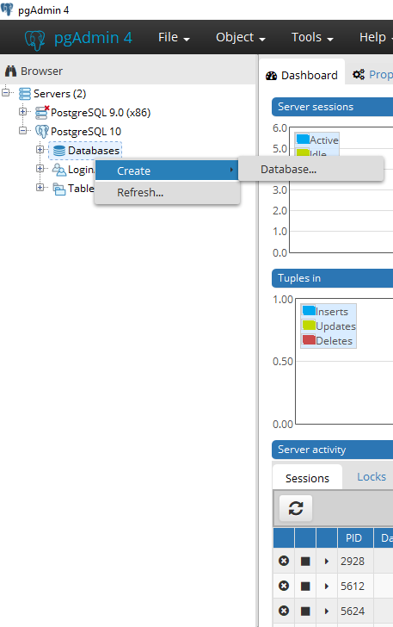
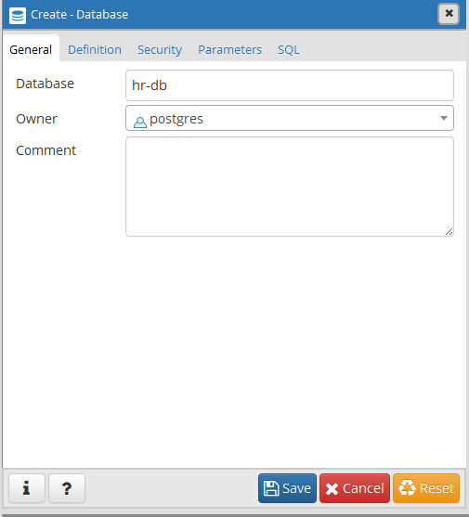
1. Create Database Server

Slide 8
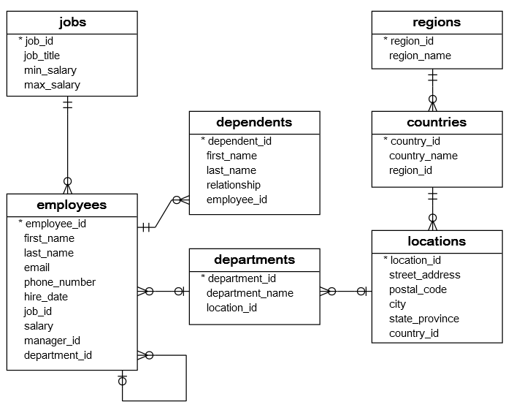
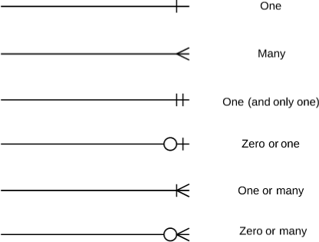
2.1. Schema Database Human Resource
Satu region memiliki
banyak countries
Notation Entity Relation (ER) Diagram
Primary Key ditandai dengan tanda *
Kotak orange primary key, kotak hijau foreign key
Relasi ke dirinya sendiri, biasa
digunakan untuk query leveling

Slide 9
2.2. How To Create Tables
Urutan Create Table
Mulai dari table master (parent table) atau table referensi terlebih dahulu, contoh:
Regions > Countries > Locations
Departments > Employees > Jobs atau Dependents
Create table with scripts

Slide 10
2.3. Data Definition Language (DDL)
TABLES
CREATE
Create tables
ADD
Add new column
RENAME
Rename column
ALTER
DROP
Drop column
MODIFY
Modify data type or length data type column
DROP
Drop Table

Slide 11
2.3.1. CREATE TABLE
TABLES
Method #1
Tipe data Serial digunakan untuk autoincrement value
CREATE
CREATE TABLE REGIONS(
REGION_ID SERIAL PRIMARY KEY,
REGION_NAME CHARACTER VARYING(25)
)
Method #2
Steps :
1
CREATE SEQUENCE REGION_ID_SEQ START 1;
Kita juga bisa gunakan autoincrement
menggunakan sequence.
2
CREATE TABLE REGIONS(
REGION_ID INT CONSTRAINT REGION_ID_PK PRIMARY KEY DEFAULT NEXTVAL('REGION_ID_SEQ'),
REGION_NAME CHARACTER VARYING(25)
)

Slide 12
2.3.2. ALTER TABLE
Table name
Column name
TABLES
ADD
ALTER TABLE regions ADD COLUMN region_x VARCHAR(25)
RENAME
ALTER TABLE regions RENAME COLUMN region_x TO region_xx
ALTER
New column name
DROP
ALTER TABLE regions DROP COLUMN region_x
MODIFY
ALTER TABLE regions ALTER COLUMN region_xx TYPE VARCHAR(30)
ADD CONSTRAINT
PK
ALTER TABLE regions ADD CONSTRAINT region_id_pk PRIMARY KEY (region_id)
Primary key name
DROP CONSTRAINT
ALTER TABLE regions DROP CONSTRAINT region_id_pk
Foreign key name
ALTER TABLE country ADD CONSTRAINT country_region_id_fk
FOREIGN KEY (region_id)
REFERENCES regions(region_id);
ADD FOREIGN KEY
Master table

Slide 13
2.3.3 DROP TABLE
TABLES
Method #1
DROP TABLE regions
DROP
Method #2
DROP TABLE regions CASCADE;

Slide 14
2.3 SCRIPT CREATE TABLE(1)
CREATE TABLE regions (
region_id SERIAL PRIMARY KEY,
region_name VARCHAR (25)
);
CHARACTER VARYING
=
VARCHAR
CREATE TABLE countries (
country_id CHARACTER (2) PRIMARY KEY,
country_name CHARACTER VARYING (40),
region_id INTEGER NOT NULL,
FOREIGN KEY (region_id) REFERENCES regions (region_id) ON UPDATE CASCADE ON DELETE CASCADE
);
CREATE TABLE locations (
location_id SERIAL PRIMARY KEY,
street_address CHARACTER VARYING (40),
postal_code CHARACTER VARYING (12),
city CHARACTER VARYING (30) NOT NULL,
state_province VARCHAR(25),
country_id CHARACTER (2) NOT NULL,
FOREIGN KEY (country_id) REFERENCES countries (country_id) ON UPDATE CASCADE ON DELETE CASCADE
);
Jika parent table column value di update,
maka otomatis child table column value
diupdate
Jika parent table column value di delete
child column table value di delete

Slide 15
2.3 SCRIPT CREATE TABLE(2)
CREATE TABLE departments (
department_id SERIAL PRIMARY KEY,
department_name CHARACTER VARYING (30) NOT NULL,
location_id INTEGER,
FOREIGN KEY (location_id) REFERENCES locations (location_id) ON UPDATE CASCADE ON DELETE CASCADE
);
CREATE TABLE employees (
employee_id SERIAL PRIMARY KEY,
first_name CHARACTER VARYING (20),
last_name CHARACTER VARYING (25) NOT NULL,
email CHARACTER VARYING (100) NOT NULL,
phone_number CHARACTER VARYING (20),
hire_date DATE NOT NULL,
job_id INTEGER NOT NULL,
salary NUMERIC (8, 2) NOT NULL,
manager_id INTEGER,
department_id INTEGER,
FOREIGN KEY (job_id) REFERENCES jobs (job_id) ON UPDATE CASCADE ON DELETE CASCADE,
FOREIGN KEY (department_id) REFERENCES departments (department_id) ON UPDATE CASCADE ON DELETE CASCADE,
FOREIGN KEY (manager_id) REFERENCES employees (employee_id) ON UPDATE CASCADE ON DELETE CASCADE
);

Slide 16
2.3. SCRIPT CREATE TABLE(3)
CREATE TABLE jobs (
job_id SERIAL PRIMARY KEY,
job_title CHARACTER VARYING (35) NOT NULL,
min_salary NUMERIC (8, 2),
max_salary NUMERIC (8, 2)
);
CREATE TABLE dependents (
dependent_id SERIAL PRIMARY KEY,
first_name CHARACTER VARYING (50) NOT NULL,
last_name CHARACTER VARYING (50) NOT NULL,
relationship CHARACTER VARYING (25) NOT NULL,
employee_id INTEGER NOT NULL,
FOREIGN KEY (employee_id) REFERENCES employees (employee_id) ON DELETE CASCADE ON UPDATE CASCADE
);

Slide 17
3.1. Insert, Update, Delete
TABLES
INSERT
insert regions (region_id,region_name) values (5,'Antartic')
insert regions (region_name) values ('Antartic')
UPDATE
update regions
set region_name ='Antartika'
where region_id=5
DELETE
delete from regions where region_id=5

Slide 18

3.2. SQL JOINS

Slide 19
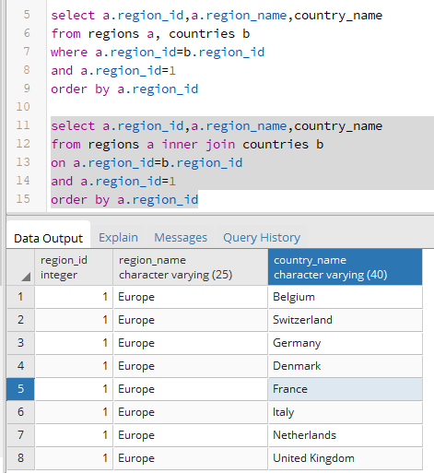
3.3 Inner Join
Method #1 ~ Paralel Execution method #1
select a.region_id,a.region_name,country_name
from regions a, countries b
where a.region_id=b.region_id
and a.region_id=1
order by a.region_id
Method #2 (Always do this method)
select a.region_id,a.region_name,country_name
from regions a inner join countries b
on a.region_id=b.region_id
where a.region_id=1
order by a.region_id

Slide 20
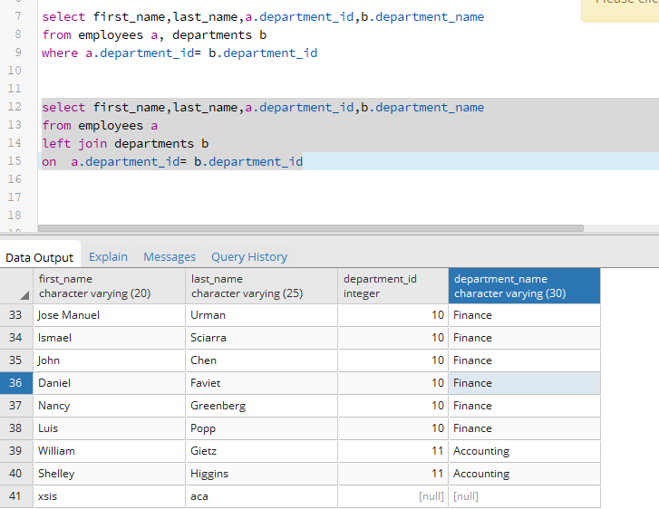
3.4 Left & Right Join
Step #1
INSERT INTO employees(employee_id,first_name,last_name,email,phone_number,hire_date,job_id,salary,manager_id,department_id) VALUES (99,'xsis','aca','xa@xsis.com','515.123.4567',DATE '1987-06-17',4,24000.00,NULL,null);
Left Join
select first_name,last_name,a.department_id,b.department_name
from employees a
left join departments b
on a.department_id= b.department_id
Right Join
select first_name,last_name,a.department_id,a.department_name
from departments a
right join employees b
on a.department_id= b.department_id

Slide 21
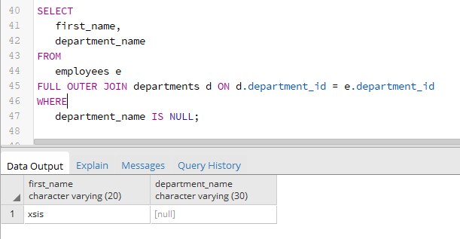
3.5 Outer Join
Query
SELECT
first_name,
department_name
FROM
employees e
FULL OUTER JOIN departments d
ON d.department_id = e.department_id
WHERE
department_name IS NULL;

Slide 22
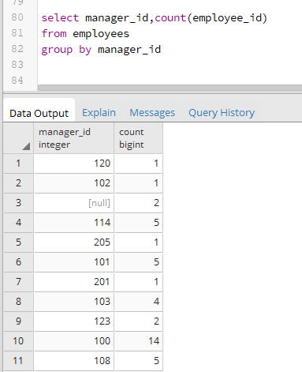
3.6 Count
SQL
select manager_id,count(employee_id)
from employees
group by manager_id
Practise
Tampilkan nama manager dan department name

Slide 23
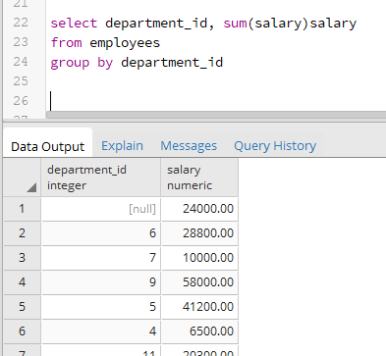
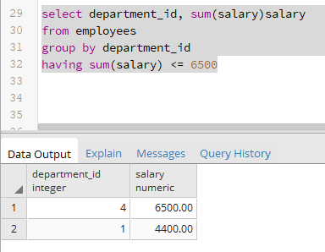
3.7 Having Sum & Group By
Before
After
select department_id, sum(salary)salary
from employees
group by department_id
select department_id, sum(salary)salary
from employees
group by department_id
having sum(salary) <= 6500

Slide 24
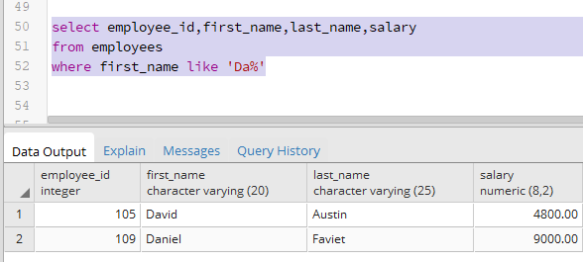
3.8 Like %
Query
select employee_id,first_name,last_name,salary
from employees
where first_name like 'Da%'

Slide 25
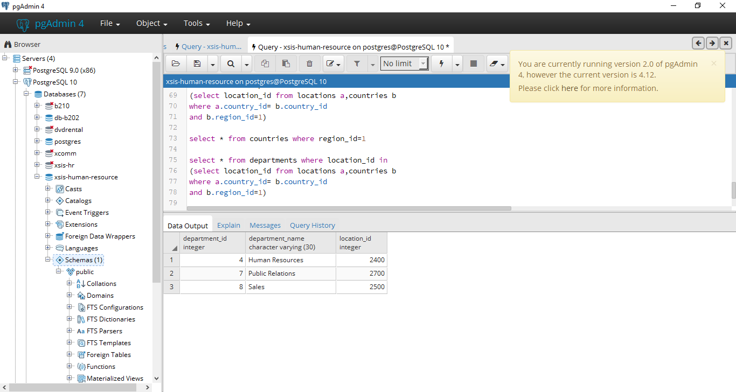
3.9 SubQuery
Query
select *
from departments
where location_id in
(select location_id from locations a,countries b
where a.country_id= b.country_id
and b.region_id=1)

Slide 26
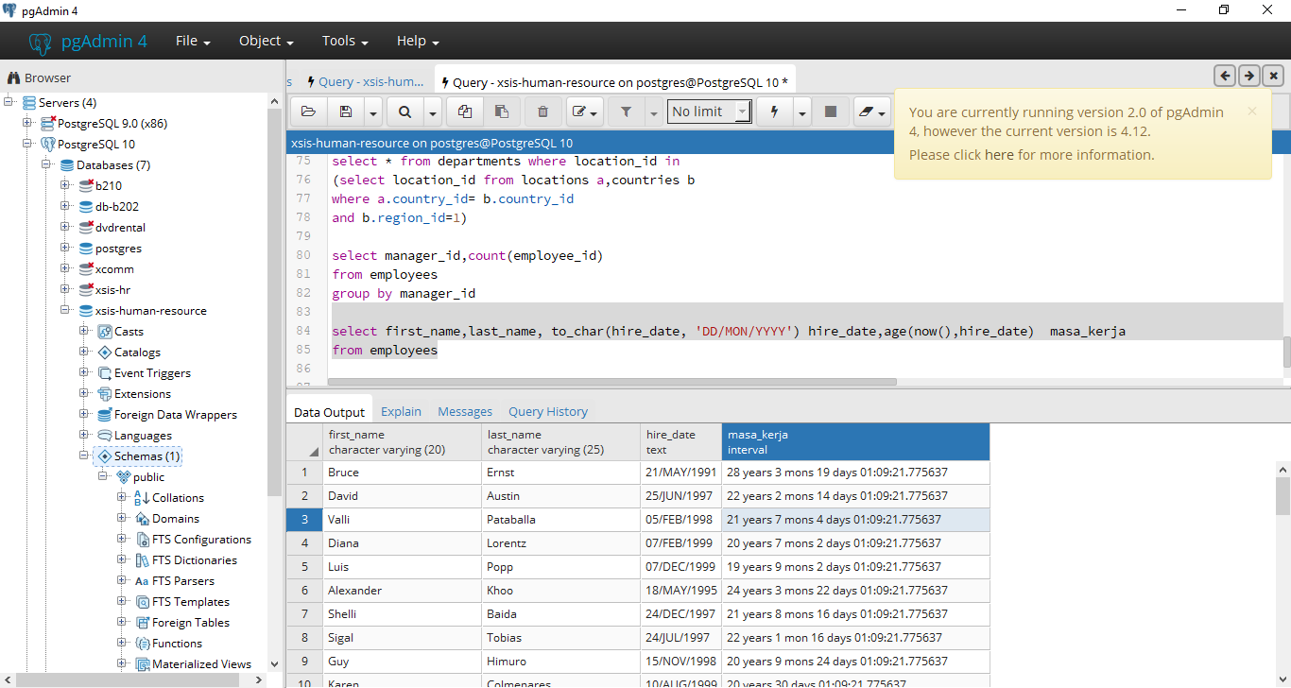
3.10. Practise (1)
1. Tampilkan data pegawai seperti dibawah ini :
select first_name,last_name, first_name||’ ‘||last_name fullname, to_char(hire_date, 'DD/MON/YYYY') hire_date,age(now(),hire_date) masa_kerja
from employees

Slide 27
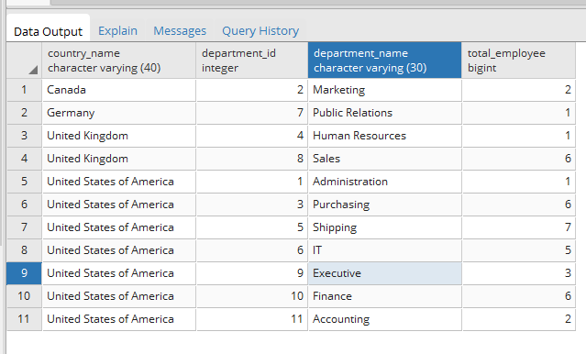
3.10. Practise (2)
1. Tampilkan data total pegawai, lalu verifikasi apakah data tiap country & department sesuai :

Slide 28
3.10. Create View
Create View
create or replace view total_employee_by_country as
select d.country_name,d.city,a.department_id,b.department_name,count(employee_id)total_employee
from employees a, departments b,
(select a.region_id,region_name,b.country_id,country_name,city,c.location_id
from regions a, countries b, locations c
where a.region_id=b.region_id
and b.country_id=c.country_id)d
where a.department_id = b.department_id
and b.location_id = d.location_id
group by d.country_name,d.city,a.department_id,b.department_name
Select View
select * from total_employee_by_country
where city='London'
Drop View
drop view if exists total_employee_by_country

Slide 29
SQL-QUIZ TIME

Slide 30
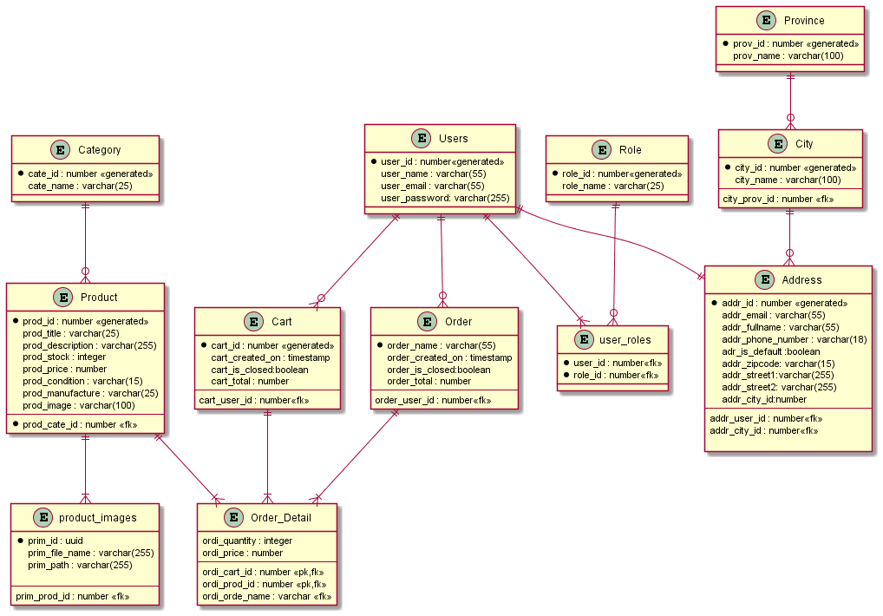
ER - Diagram

Slide 31
Quiz 1
Buat DDL (Create Table, Primary Key, ForeignKey)
Untuk table master/referensi, insert data minimal 3 record
Untuk table transaksi insert data minimal 5 recod.
Table Order, untuk attribute order_name memiliki format = ORD-TGLBULANTAHUN-Sequence, contoh : ORD-040221#0001

Slide 32
Quiz 2
Buat query untuk menampilkan :
a. Tampilkan total product by category :
c. Tampilkan jumlah order tiap customer :
CategoryName | TotalProduct
Laptop | 5
Handphone | 3
Alat Olahraga | 2
Username | Email | TotalOrder
Agus | agus@gmail.com | 3
Budi | budi@gmail.com | 12
b. Tampilkan total order by product :
d. Total Order per bulan filter by tahun :
ProductName | TotalOrder
Laptop Asus | 3
Laptop Dell | 5
Samsung S3 | 7
Sepeda | 2
Bulan | TotalOrder
Januari | 3
Februari | 2
-
Desember | 0

Slide 33
Quiz 3
e. Total Pendapatan Perbulan filter by tahun :
f. Total Order per Kota yang di filter oleh Provinsi, contoh jika di filter provinsi Jawa Barat, yang tampil kota yang ada di jawabarat.
Bulan | TotalRevenue
Januari | 5000
Februari | 6000
-
Desember | 0
City | TotalOrder
Bandung | 12
Bogor | 5

